Slide 1
Async Await and their pitfalls
Source code: https://github.com/sflusov/AsyncAwaitPitfalls

Slide 2
Agenda
What does the “await” keyword do? How does “await” relate to the current SynchronizationContext?
When at last you “await”?
What happens when I combining "await" and synchronization primitives.
What happens when I combining "await" and loop? Implementing a simple. ForEachAsync.
Where I can’t use “await”?
Why I should prefer Task.Run vs Task.Factory.StartNew

Slide 3
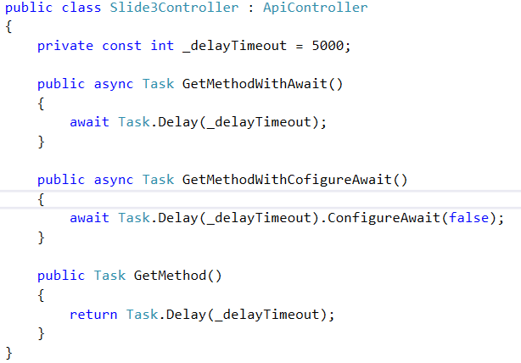
The simplest example of Async Await
Goal:
I want to write the simplest and the fastest implementation of API method.
Questions:
Should I always use "async await" for creation async-method of controller?
How the methods return task, when they doesn't contain return keyword.
What difference between this method by execution?
How long methods will execution?
Which method will faster on high load?

Slide 4
Conclusion from slide
You can create asynchronous method based on "Task" without use keyword "async await" on top level.

Slide 5
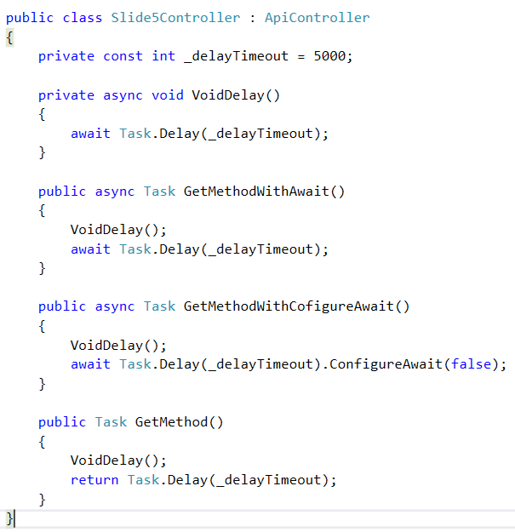
The simplest example with Async void method Where I can’t use “await”?
Goals:
I want to call the BL method and expect that execution time will increase
Questions:
How long methods will execution?
Why state machine doesn't wait for the completion of first awaiter
How we should resolve this problem?

Slide 6
Conclusion from slide
Avoid async void. Prefer async Task methods over async void methods.
Exception: Event handlers (fire & forget)
Source: https://msdn.microsoft.com/en-us/magazine/jj991977.aspx
Paragraph: Avoid Async Void

Slide 7
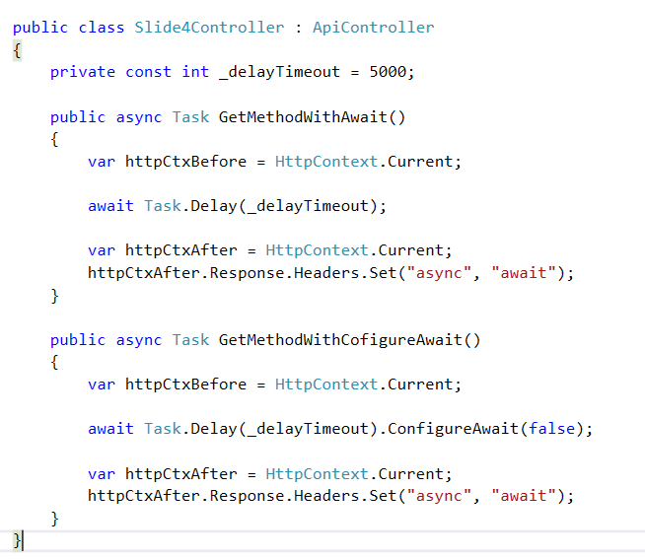
Modification HttpContext & Async Await (Part 1) How does “await” relate to the current SynchronizationContext?
Goals:
In this case I want to write custom header in http message
Questions:
What difference between this method by execution?
What problems we will get in those cases?
What does ConfigureAwait(false) do?
How we should resolve this problem?

Slide 8
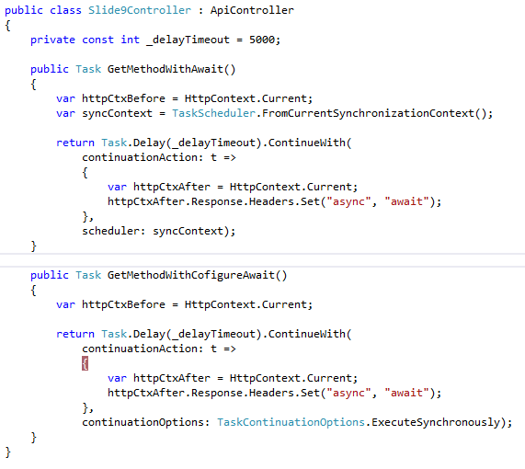
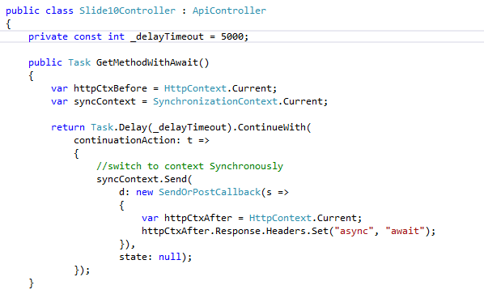
Modification HttpContext & Async Await (Part 2) Examples context switch without "await"

Slide 9
Conclusion from slide
You should not use ConfigureAwait when you have code after the await in the method that needs the context.
For GUI apps, this includes any code that manipulates GUI elements, writes data-bound properties or depends on a GUI-specific type such as Dispatcher/CoreDispatcher.
For ASP.NET apps, this includes any code that uses HttpContext.Current or builds an ASP.NET response, including return statements in controller actions
Source: https://msdn.microsoft.com/en-us/magazine/jj991977.aspx
Paragraph: Configure Context

Slide 10
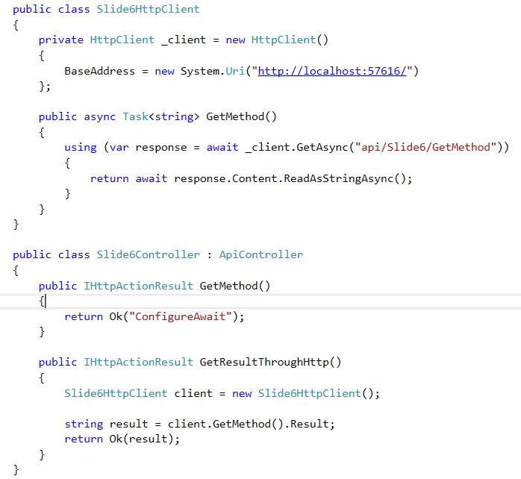
When at last you “await”? (Part 1)
Goals:
I want to mix asynchronous and synchronous methods for better performance
Questions:
What problems does this code contains?
How we should resolve this problem?

Slide 11
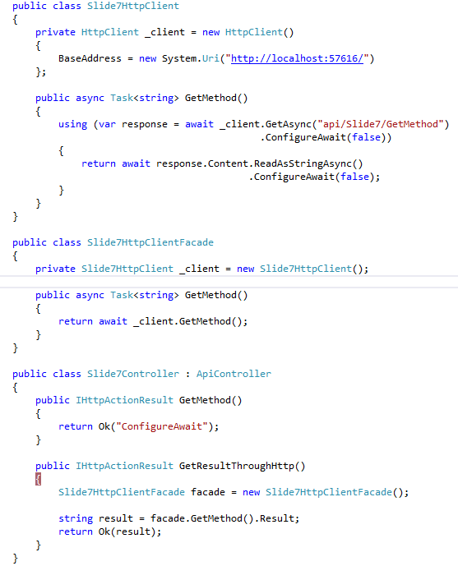
When at last you “await”? (Part 2)
Goals:
I want to mix asynchronous and synchronous methods for check result
Questions:
What problems does this code contains?
How we should resolve this problem?

Slide 12
Conclusion from slide
Each async method has its own context, so if one async method calls another async method, their contexts are independent.
When you write "Facade" over Task based method you should throwing Task<T> without use "async await" on top level.
Source:
https://msdn.microsoft.com/en-us/magazine/jj991977.aspx (Paragraph: Configure Context)
Example:
https://github.com/dotnet/corefx/blob/master/src/System.Net.Http/src/System/Net/Http/HttpClient.cs

Slide 13
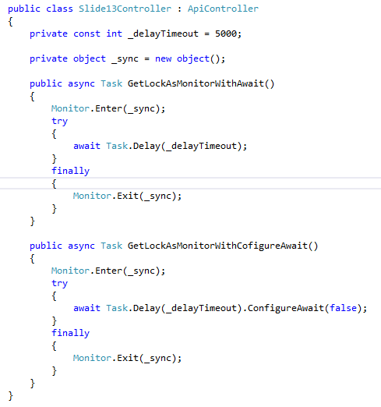
What happens when I combining "await" and synchronization primitives. (Part 1)
Goals:
We have a shared resource access to which via Lock
Questions:
Which method will work?
How long the methods will execution?

Slide 14
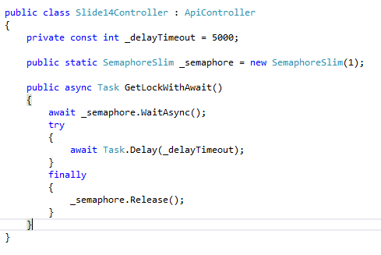
What happens when I combining "await" and synchronization primitives. (Part 2)

Slide 15
Conclusion from slide
You can’t use await inside of a lock/SyncLock block.
You can also read about building a variety of custom async synchronization primitives at:
Building Async Coordination Primitives, Part 1: AsyncManualResetEvent
...
Building Async Coordination Primitives, Part 6: AsyncLock
Building Async Coordination Primitives, Part 7: AsyncReaderWriterLock
Source:
https://blogs.msdn.microsoft.com/pfxteam/2012/04/12/asyncawait-faq/ (Where can’t I use “await”?)
Example:
https://blogs.msdn.microsoft.com/pfxteam/2012/02/12/building-async-coordination-primitives-part-6-asynclock/

Slide 16
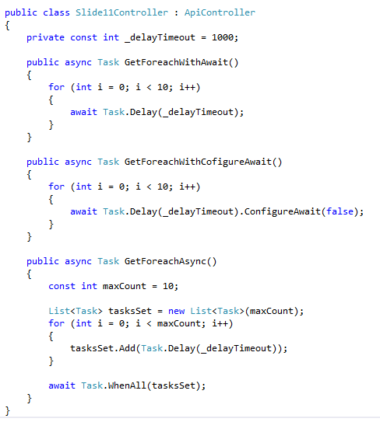
What happens when I combining "await" and loop? (Part 1)
Goals:
I want to call methods based on Task asynchronously and parallelly.
Questions:
How long the methods will execution?
What happens when I change Task.Delay on HttpClient.Post and set maxCount = 1000? (What problems do you know?)

Slide 17
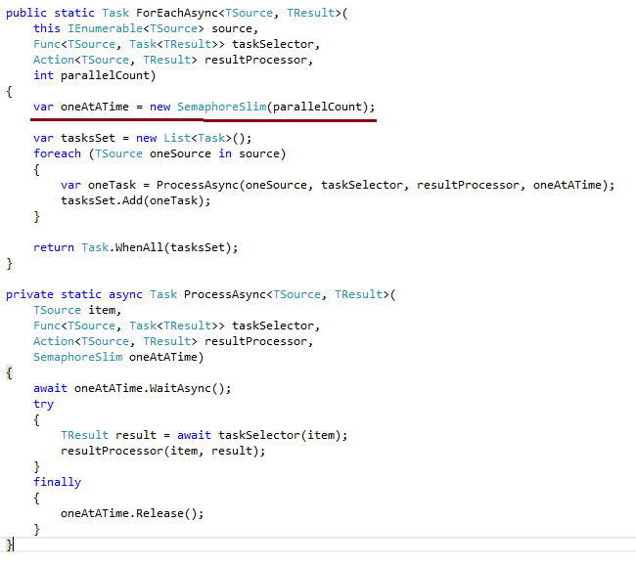
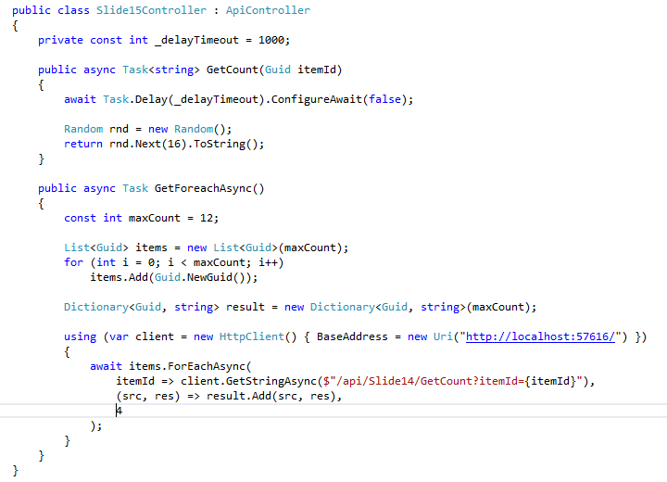
Implementing a simple ForEachAsync (Part 2)
Source: https://blogs.msdn.microsoft.com/pfxteam/2012/03/04/implementing-a-simple-foreachasync/

Slide 18
Conclusion from slide
If you want implement "foreach async" you could use "Task.WhenAll" or "Task.WhenAny“
But you must understand how many tasks will work simultaneously
Sources:
https://blogs.msdn.microsoft.com/pfxteam/2012/03/04/implementing-a-simple-foreachasync/
https://blogs.msdn.microsoft.com/pfxteam/2012/03/05/implementing-a-simple-foreachasync-part-2/

Slide 19
Where I can’t use “await”?
Inside of a lock/SyncLock block. For a discussion of why this is disallowed, as well as for a look at SemaphoreSlim.WaitAsync (which can be used with await).
With most aspects of LINQ query comprehension syntax. “await” may only be used in a query expression within the first collection expression of the initial “from” clause or within the collection expression of a “join” clause.
Inside of an unsafe region. Note that you can use the “unsafe” keyword inside of a method marked as “async”, you just can’t use “await” inside of an unsafe region. This restriction has to do with how the compilers preserve state across an “await” point, and difficulties inherent to preserving unmanaged pointers.

Slide 20
Thank you
Recommend to read: https://blogs.msdn.microsoft.com/pfxteam
Source code: https://github.com/sflusov/AsyncAwaitPitfalls

